Slide 1

Decoding Mushroom Toxicity with Logistic Regression Analysis
Presented By
Shams E Alam Prianka

Slide 2
Introduction
Goal: Classify mushrooms as Toxic or Non-toxic.
Dataset: UCI Mushroom Dataset
Methodology: Logistic Regression with Gradient Descent

Slide 3
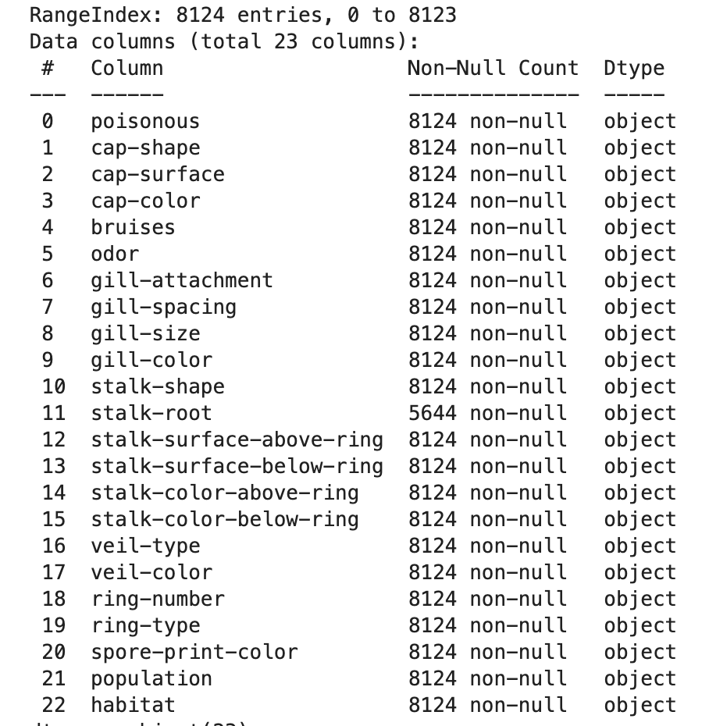
Dataset Overview
8124 instances, 22 categorical features
Target: Edibility (Edible vs Poisonous)
Missing values in ‘stalk-root’ feature

Slide 4
Why this Dataset?
Categorical-only data
Clean, structured
Ideal for binary classification
Clear patterns in variables
Has missing values as per our project’s requirement.

Slide 5
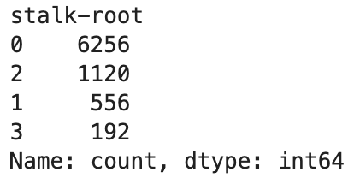
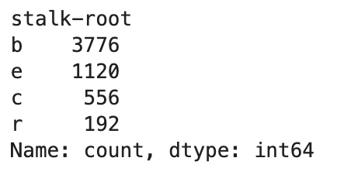
Data Preprocessing
Handled missing values ('?' → NaN)
Label encoding of all features
Example: odor, gill-size, cap-shape
Odor: almond = 0, foul = 2, etc.
Cap color, bruises, spore print color

Slide 6
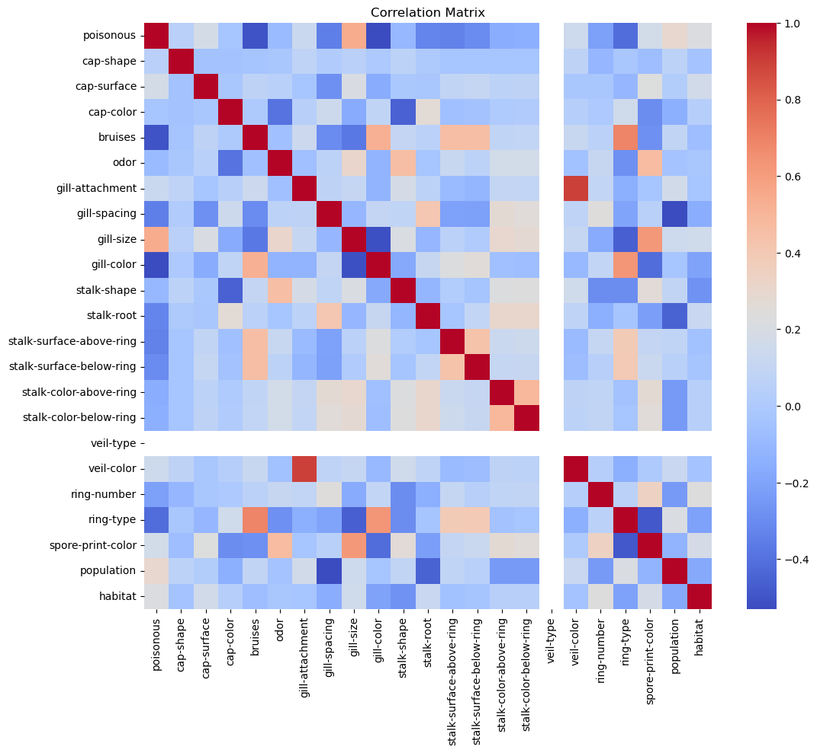
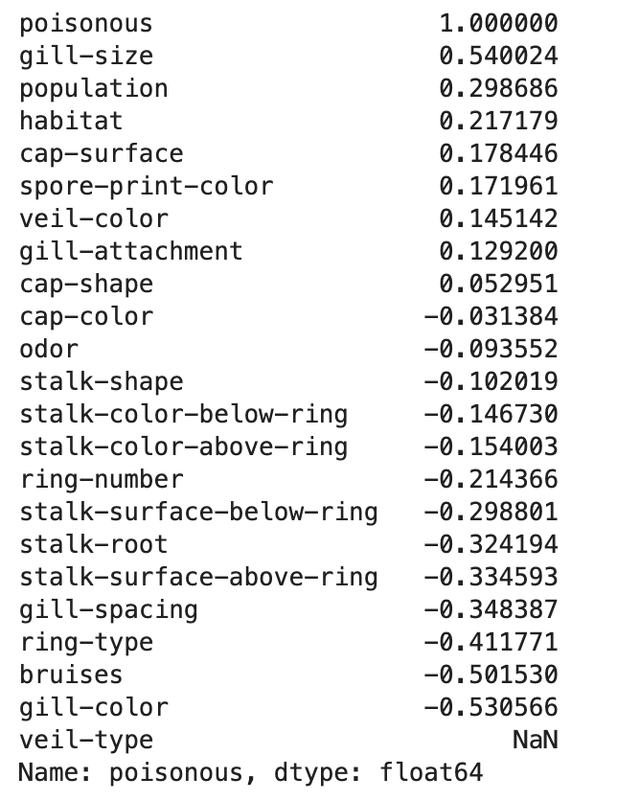
Correlation Analysis
Feature correlation with toxicity
Top predictors: gill-size, gill-color, bruises
Multicollinearity minimal

Slide 7
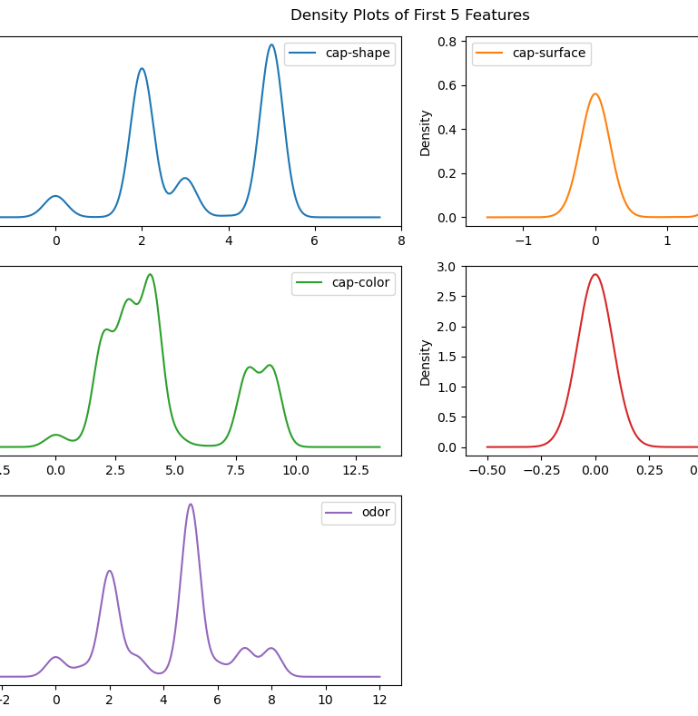
Exploratory Data Analysis
Density plots: odor, cap-color

Slide 8
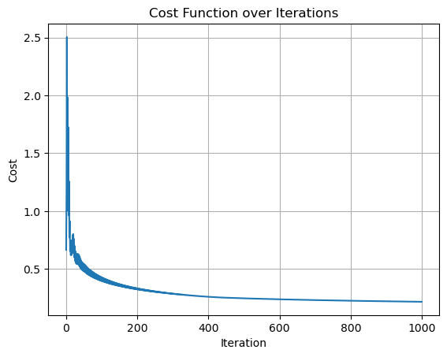
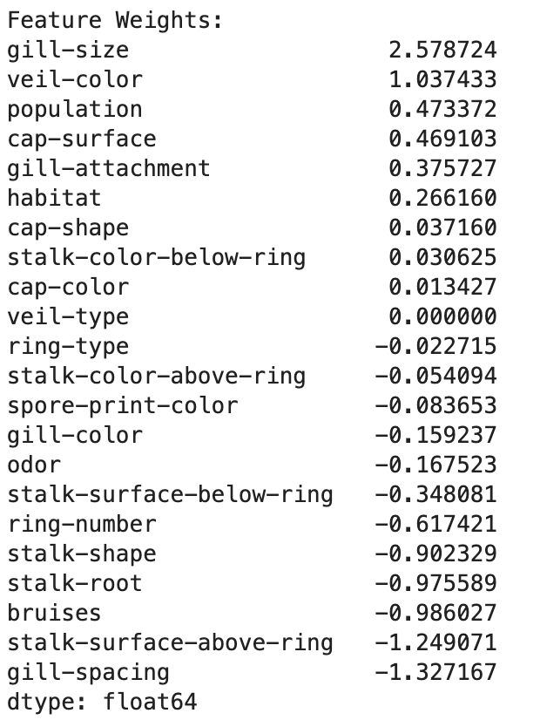
Logistic Regression From Scratch
Gradient Descent
Learning Rate: 0.1 (optimal)
Iterations: 1000
Convergence tolerance: 1e-6
Sigmoid activation and Bias term included

Slide 9
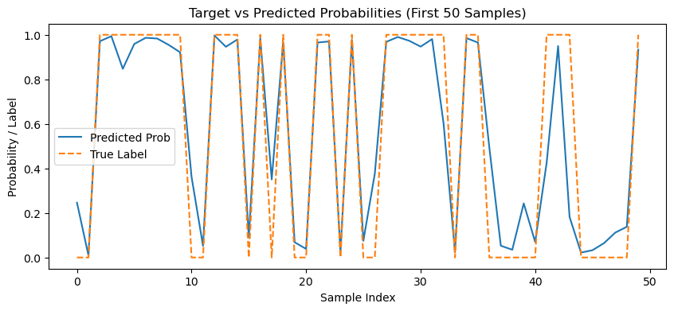
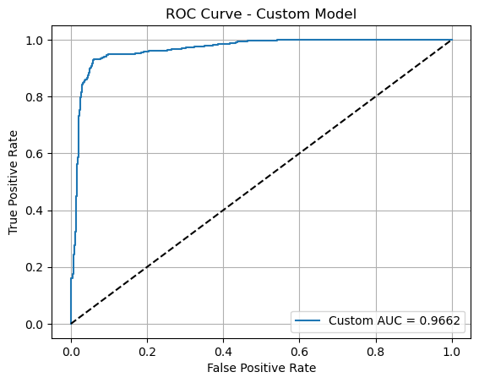
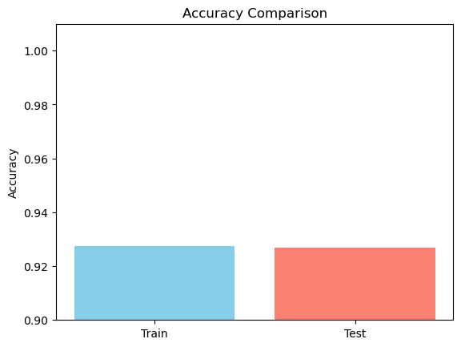
Logistic Regression From Scratch

Slide 10
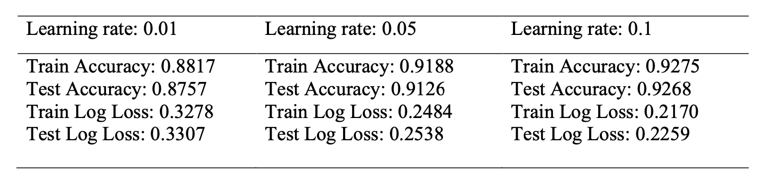
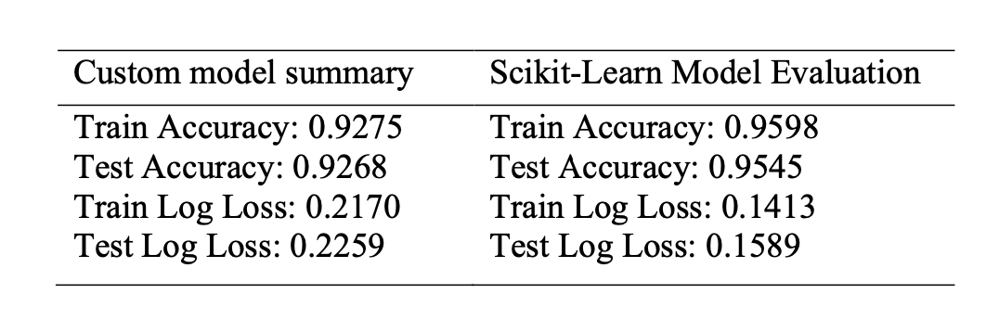

Slide 11
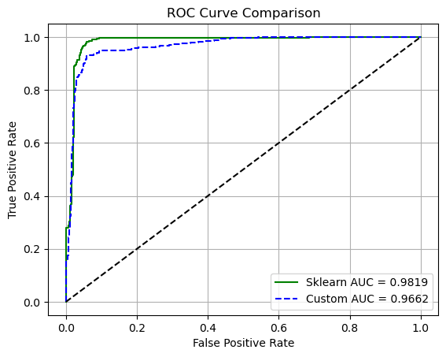
ROC Curve Comparison
Custom Model AUC: 0.9662
Sklearn Model AUC: 0.9819
Both show excellent separation

Slide 12
Why the High Accuracy?
No mislabeled data
Proper preprocessing & tuning
Sklearn uses L2 regularization
Missing value treatment
Learning rate and convergence settings were properly tuned

Slide 13
Conclusion & Insights
Logistic Regression is effective for binary classification
High interpretability
Custom model performance close to Sklearn
Dataset structure played a key role

Slide 14
Thank You!

Slide 15

Questions?

